Slide 1
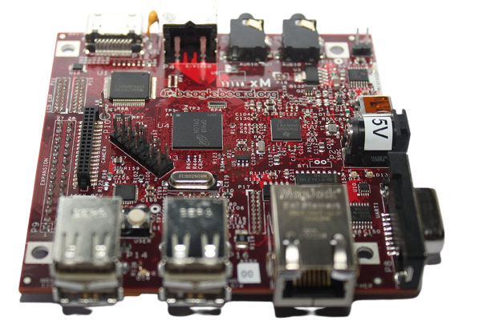
Beagle board

Slide 2
What is beagle board
Introduced on July 28, 2008
A low-power open-source single-board computer
Designed with open source software development in mind

Slide 3
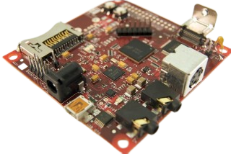
What is beagle board
designed using Cadence OrCAD for schematics and Cadence Allegro for PCB manufacturing
no simulation software was used

Slide 4
features
Measures approximately 75mm x 75mm
Has all functionality of a basic computer
Built-in storage and memory provided through a PoP chip
256MB if NAND flash memory & 256MB of RAM
(128MB on earlier models)
Uses upto 2W of power
Can be powered from the USB connector
Separate 5V can also be provided

Slide 5
Rev. c4 specification
Package on package (PoP) SoC/Memory chip
Processor TI OMAP3530 SoC – 720 MHz ARM Cortex-A8 core
"HD capable" TMS320C64x+ core (520 MHz up to 720p @30 fps)
Imagination Technologies PowerVR SGX 2D/3D graphics processor supporting dual independent displays
256 MB LPDDR RAM
256 MB NAND Flash memory

Slide 6
Rev. c4 specification
Peripheral connections
DVI-D (HDMI connector chosen for size – maximum resolution is 1280 × 1024 – and it does not output digital audio)
S-Video
USB OTG (mini AB)
1 USB port

Slide 7
Rev. c4 specification
Peripheral connections
SD/MMC card slot
Stereo in and out jacks
RS-232 port
JTAG connector
Power socket (5 V barrel connector type)

Slide 8
Rev. c4 specification
Development
Boot code stored in ROM
Boot from NAND memory, SD/MMC, USB, or serial
Alternative boot source button.

Slide 9
Rev. c4 specification
Development
Has been demonstrated using Android, Angstrom Linux, Fedora, Ubuntu, Gentoo, Arch Linux ARM, openSUSE for ARM and Maemo Linux distributions, VxWorks, FreeBSD, the Windows CE operating system, Symbian, QNX and a version of RISC OS 5 made available by RISC OS Open.

Slide 10
Use of beagle board
developed by a small team of engineers as an educational board that could be used in colleges around the world to teach open source hardware and software capabilities
to provide users a powerful computer at a low cost with few restrictions
to provide users the open source hardware details so as to continually improve the product line by keeping the line fresh with new innovations.
powerful computing power and small physical size allows them to be used in wide variety of projects

